Slide 1
BI23
Business Intelligence Report for an E-Commerce business

Slide 2
Business Intelligence Report for an E-Commerce business
1. Approach
2. Step 1: Ask
Agenda
3. Step 2: Prepare
4. Step 3: Process
5. Step 4: Analyze
6. Step 5: Share
7. Step 6: Act

Slide 3

Business Performance
Topics to be covered
Customer Satisfaction

Slide 4
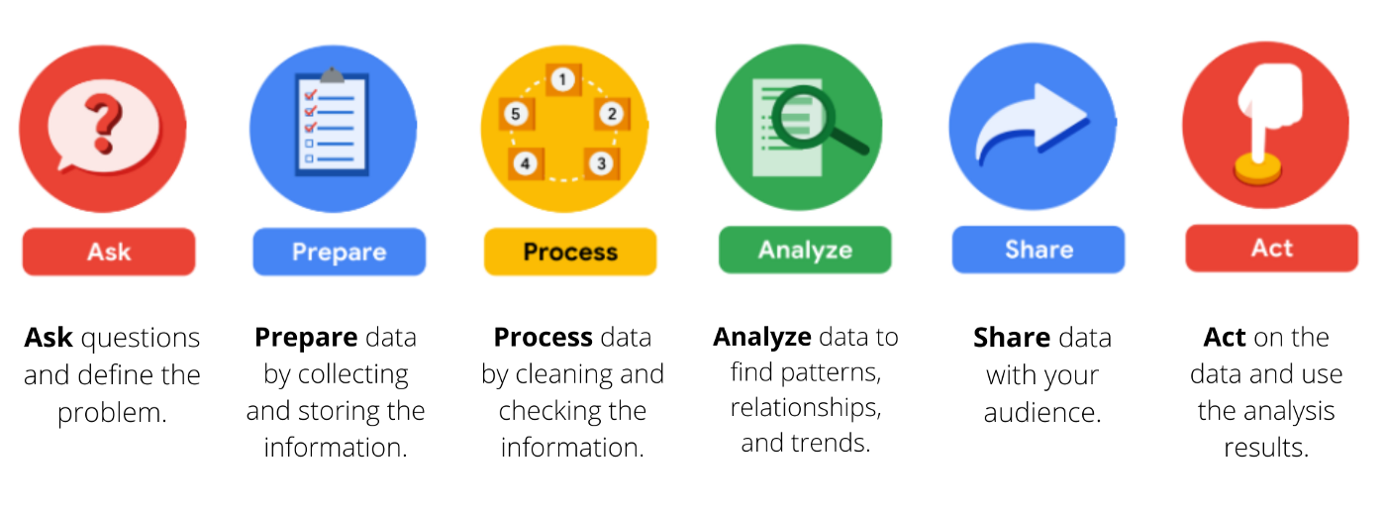
1 – Approach
Six steps of Analyzing this dataset

Slide 5

2. First step – Ask
Business Performance
Topics to be covered in the report:
In terms of sales:
Total Sales revenue
Sales growth (comparing to Sales in previous year)
Average Sales and Items Sold per Order
Sales Performance over time
Comparison between Current Year Sales and Previous Year Sales, mentioning Sales Growth YoY (Year over year)
Top 5 product categories having highest Sales Revenue
Top 5 cities having highest Sales Revenue
Sales Performance per Payment type

Slide 6
2. First step – Ask
Business Performance
Topics to be covered in the report:
In terms of orders:
Total Sold Items
Total Orders
Orders Growth (Comparing to previous year)
Total orders over time
Overview of Orders based on each kind Review Score(Average order processing days, Average total items, Average, Order Price)
Top 5 cities having highest number of orders
Top 5 product categories having highest number of orders
Orders per Payment type

Slide 7
2. First step – Ask
Customer Satisfaction
Topics to be covered in the report:
Total Customers
Customers Growth (comparing to the previous year)
Total new customers
Total regular customers
Customer growth over time
Average response time for each kind of Review
Average review score over time
Count of review score

Slide 8
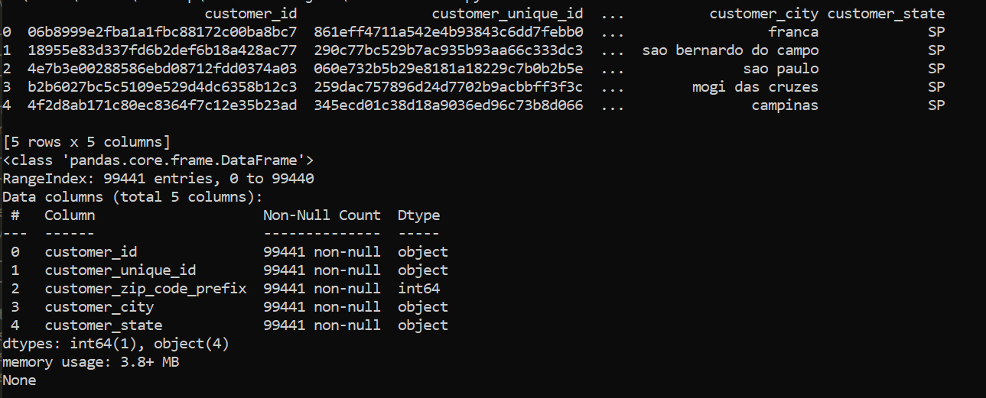
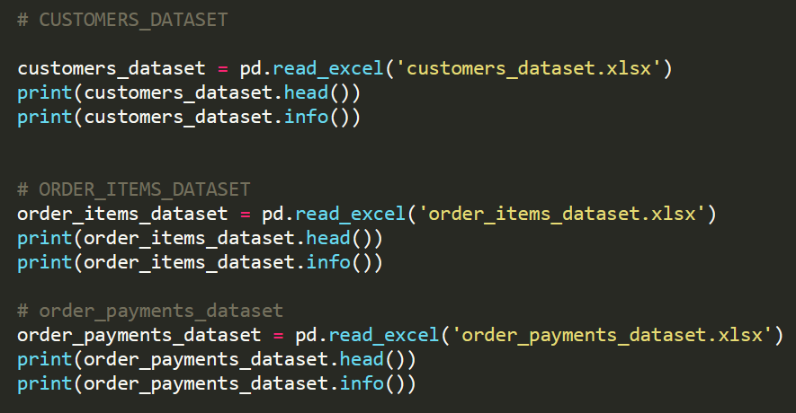
3 – Second step: Prepare
Collecting data and EDA
Sample results
Using Python for EDA, sample code:
Key findings:
First 5 records of a dataset
Details of a dataset: its column header name, datatype and total numbers of non-null records

Slide 9
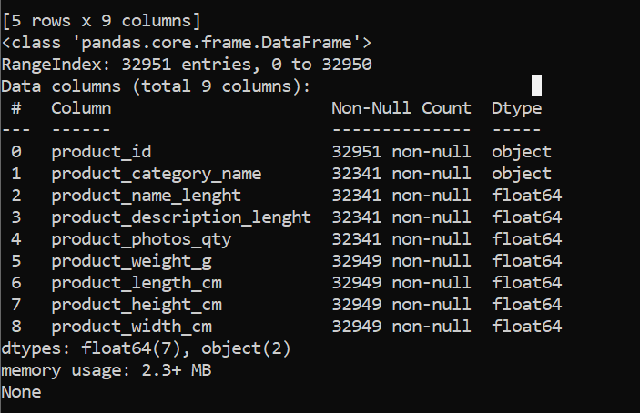
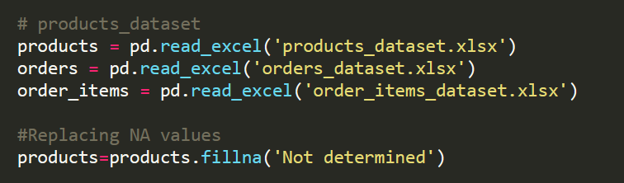
3 – Second step: Prepare
Cleansing Data using Pandas
Solution
Solution: Either using Python or SQL to cleanse/remediate current dataset
It can be noticed that products_dataset is having multiple null values:

Slide 10
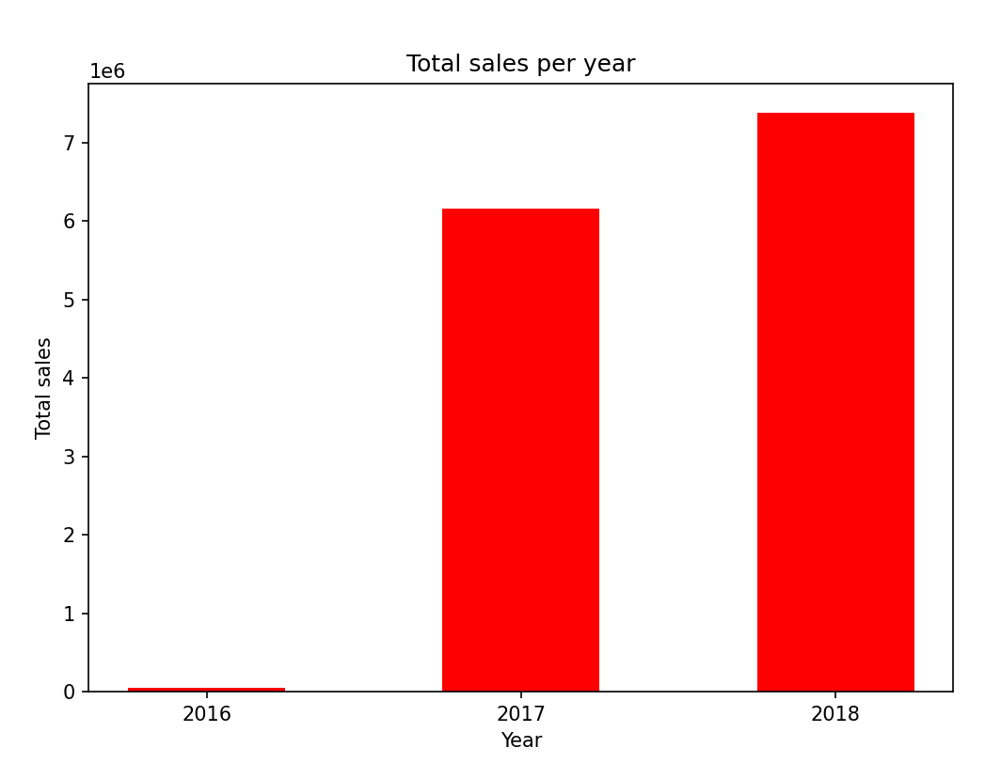
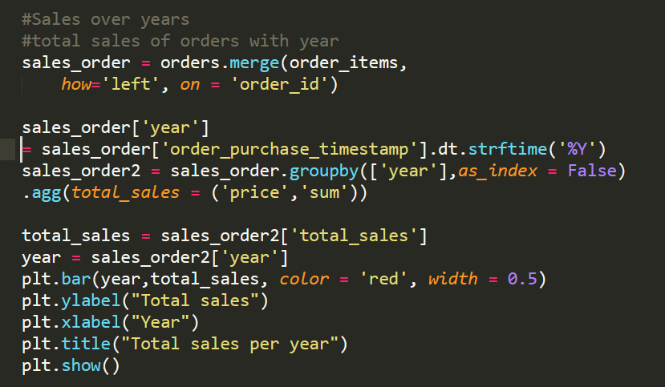
3 – Second step: Prepare
Visualization using Matplotlib
Sample result

Slide 11
4 – Third step: Process
with cte as(
select p.product_id, p.product_category_name,
isnull(p.product_name_lenght,0) product_name_length,
isnull(p.product_description_lenght,0) product_description_length,
isnull(p.product_photos_qty,0) product_photos_qty,
isnull(p.product_weight_g,0) product_weight_g,
isnull(p.product_length_cm,0) product_length_cm,
isnull(p.product_width_cm,0) product_width_c,
isnull(pt.product_category_name_english, 'Not determined') product_category_name_english
from products p
left join product_category_name_translation pt on p.product_category_name = pt.product_category_name
)
select *
into product_cleansed
from cte
Cleansing product Table

Slide 12
4 – Third step: Process
with cte as (
select o.order_id,o.customer_id, count(ors.review_id) total_reviews
from orders o
left join order_reviews ors on o.order_id = ors.order_id
group by o.order_id,o.customer_id)
select c.customer_id, c.customer_unique_id, c.customer_zip_code_prefix, c.customer_city, c.customer_state, count(o.order_id) total_order,
case
when count(o.order_id) < 2 then 'New customer'
when count(o.order_id) > 5 then 'Regular customer'
end customer_type,
sum(cte.total_reviews) total_reviews
into customers_enriched
from customers c
left join orders o on c.customer_id = o.customer_id
left join cte cte on c.customer_id = cte.customer_id
group by c.customer_id, c.customer_unique_id, c.customer_zip_code_prefix, c.customer_city, c.customer_state
order by total_reviews desc
Enrich Customer Table Data

Slide 13
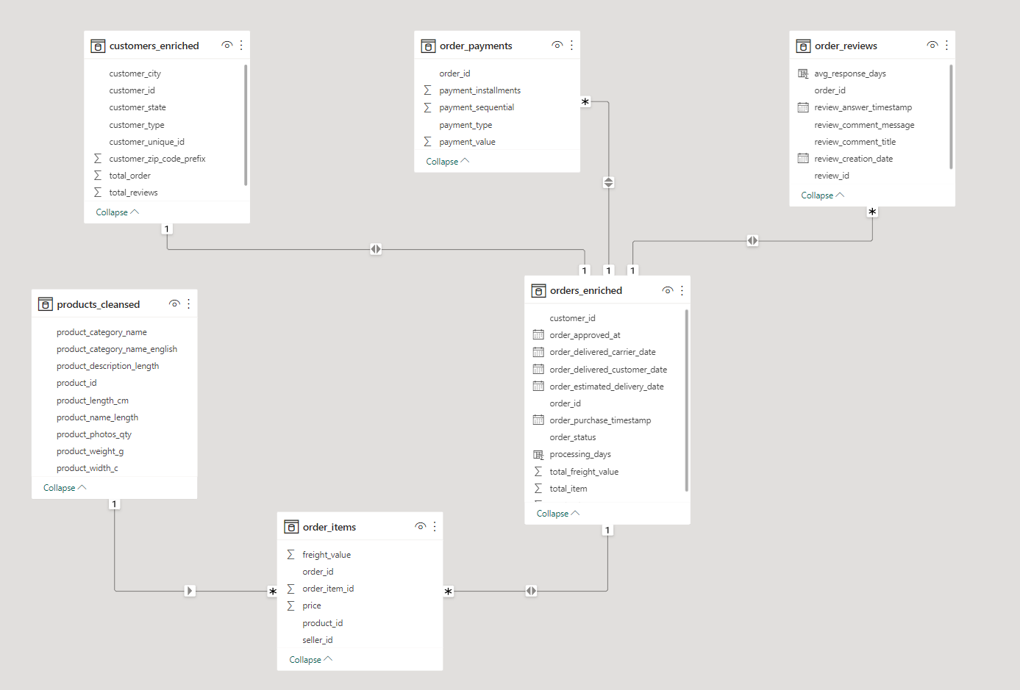
5 – Fourth step: Analyze

Slide 14
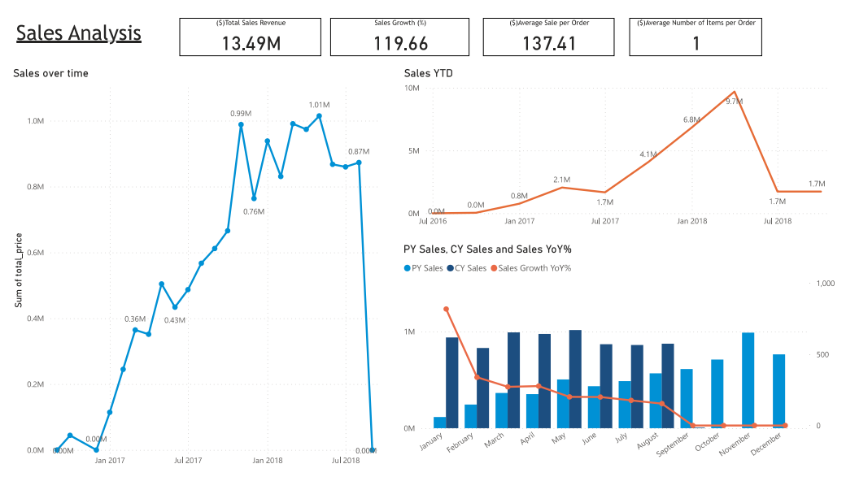
5 – Fourth step: Analyze - Visualization

Slide 15
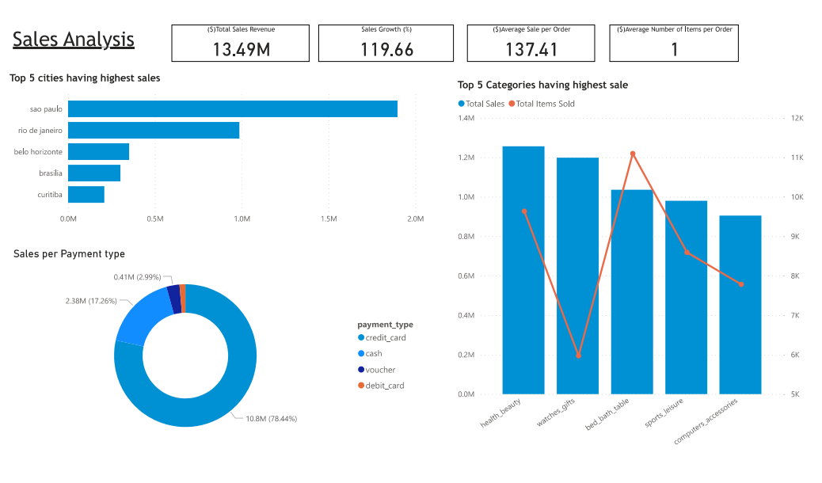
5 – Fourth step: Analyze - Visualization

Slide 16
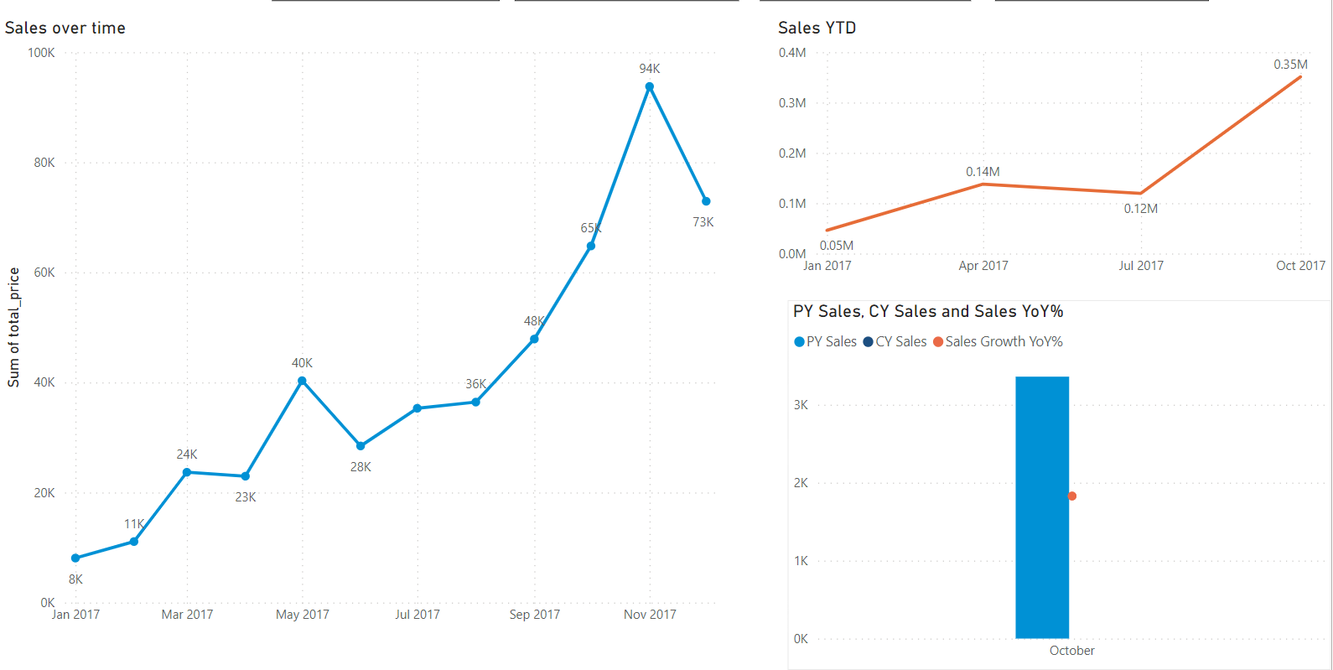
5 – Fourth step: Analyze – Deep dive on Sales of 2017

Slide 17
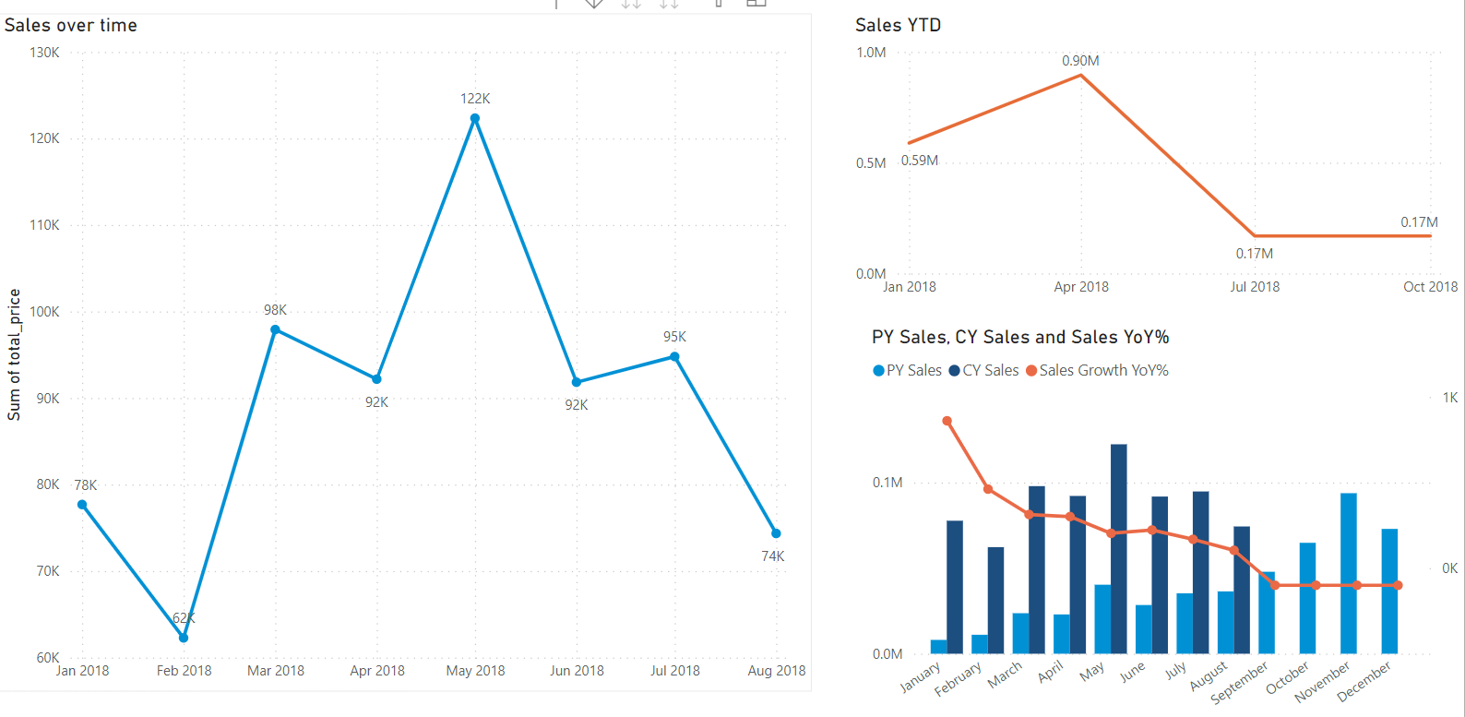
5 – Fourth step: Analyze – Deep dive on Sales of 2018

Slide 18
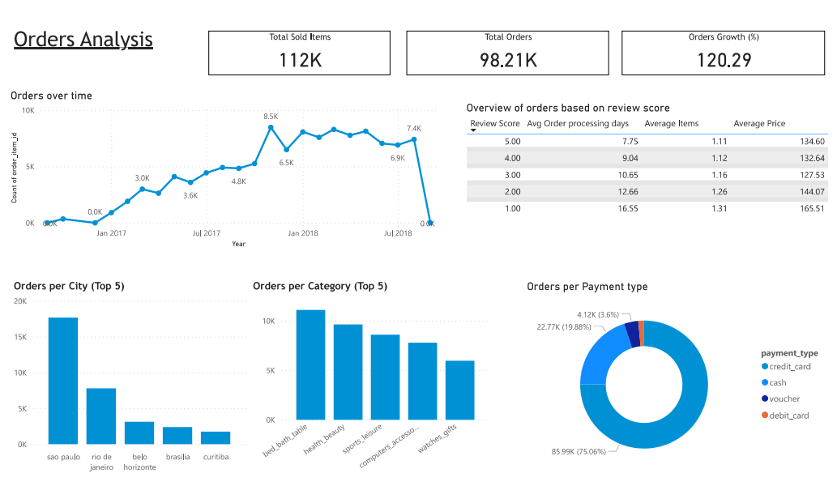
5 – Fourth step: Analyze - Visualization

Slide 19
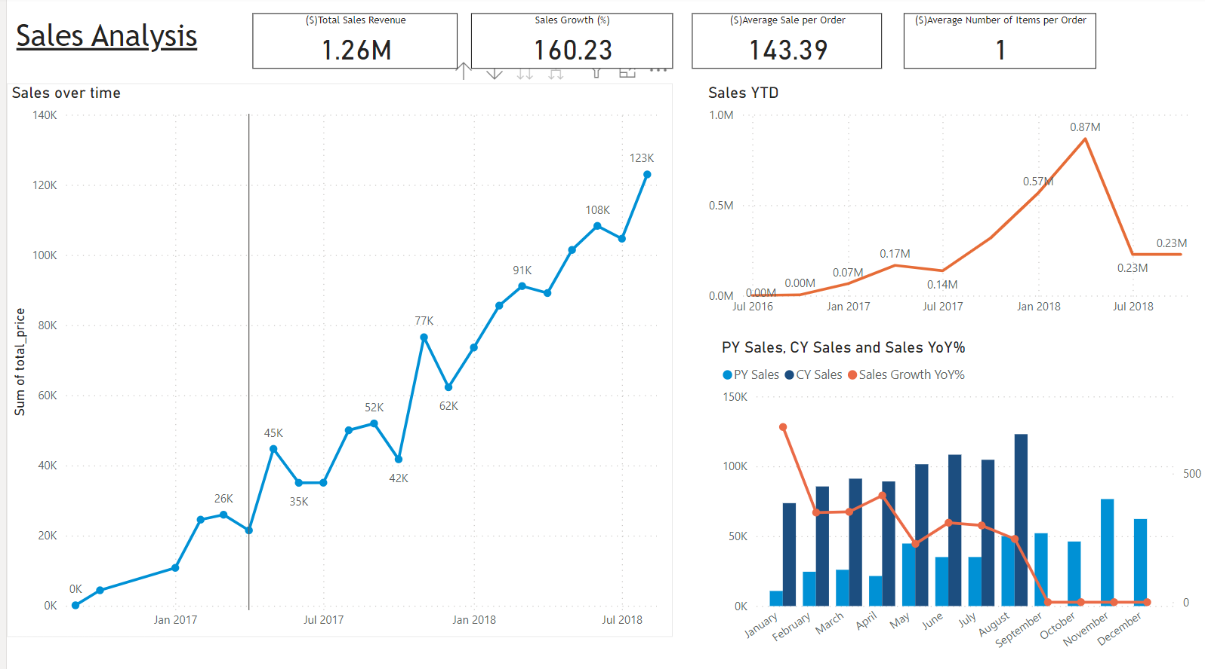
5 – Fourth step: Deep dive on health beauty products

Slide 20
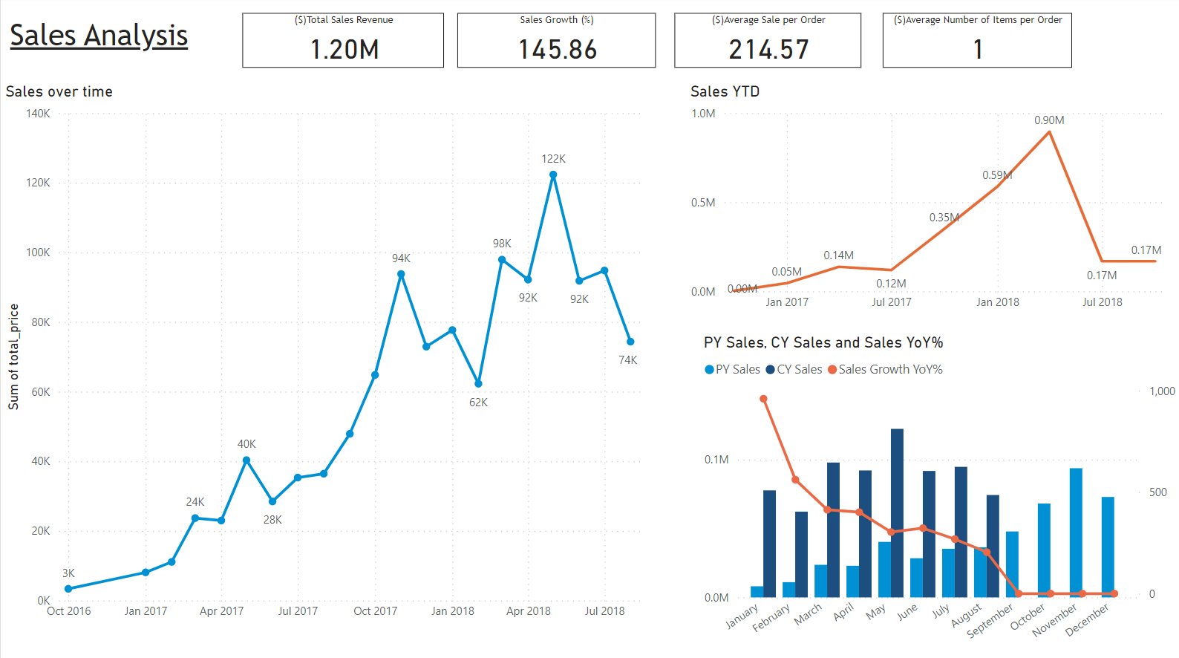
5 – Fourth step: Deep dive on watches_gifts products

Slide 21
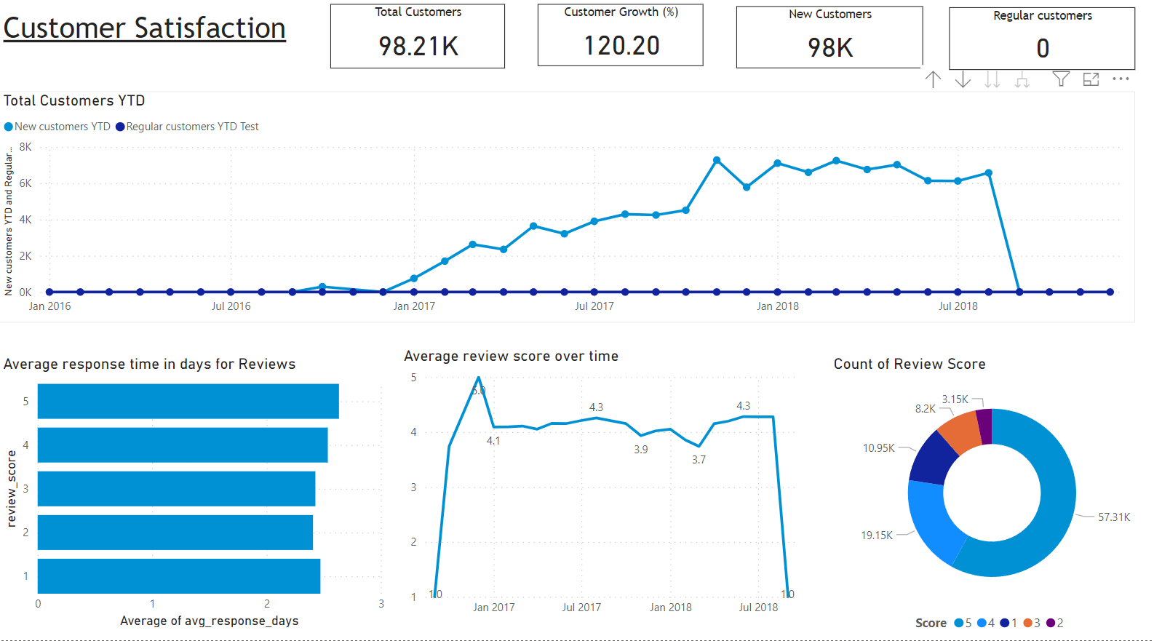
5 – Fourth step: Visualization – Customer

Slide 22
6 – Fifth step: Share
Summarize Key Insights
Business Performance:
Comparing to previous year, Sales is almost doubled in every month (not counting from September onwards)
From March to May, business reached its peak performance while having highest sales revenue comparing to other months
Sao Paulo remains as a city having the highest sales revenue and total number of orders
Health & Beauty product is the most popular product while having highest sales revenue among other products. Also, it can be noticed that watches&gifts products having the second highest sales whilst having significantly lower number of sold items comparing to Health&Beauty items sold
In terms of Orders, regarding orders categorized by reviews. Among orders categorized by review score, It can be pointed out that orders having 1 review score having highest average total price while having highest amount of time to process an order
Last but not least, most of the orders are paid using Credit card, while cash come as the second most popular payment method

Slide 23
6 – Fifth step: Share
Summarize Key Insights
Customer Satisfaction:
Over the years, total number of new customers keep growing while regular customer remains the same. Which also can be referred that customer tend to order only 1 time
In terms of the review score, more than 50% of the orders were rated 5
Furthermore, it can be positively pointed out that review scores over months are stable since most of them ranged from 3.5 to 4.5

Slide 24
7 – Sixth step: Act
Key Insights/Issues
Recommendations/Actionable Items
Customers tend to order approximately only 1 item per order
Sales Revenue in Sao Paulo is much higher than the Sales amount in other cities. Noticeably it is almost doubled when comparing to the sales amount in Rio de Janeiro, which came as the second highest sales revenue
Credit card is the most popular payment method: 78% of payment transactions were made using Credit card
In terms of Product Categories, among other top 5 products having highest sales revenue, the sales amount of watches_gifts came as second while its total numbers of sold items is significantly lower than others’
Comparing to other orders categorized by review_score, orders having review score as 1 have the highest orders processing days while average total price of those orders is the highest
All customers only had 1 purchase in this platform
There is no regular customers (customers having more than 3 orders can be treated as regular)
Customers are not clearly segmented for analysis purposes
Majority of the reviews were scored 5
1. To encourage customers to buy more than 1 item, creating deals or bundles for customers when purchasing more than 1 item within an Order
2. Creating campaigns to promote business’s activities in other cities
3. Collaborate with other digital payment vendors to promote their e-payment solutions
4. Creating campaigns to promote watches_gifts products
5. Considering improve Operations’ activities to reduce order processing days for orders having high value
6. Improve or implement new customer journey to encourage customers to order after the first purchase
7. Create campaigns to promote the benefits of being regular customers
8. Create campaigns or require customers to fill in their personal information while conducting registration
9. Keep all the customers, especially who have given 5 stars review, to be updated on the promotions or deals of the business.

